Slide 1
Applications of CYGNUS GSM Based Equipment Controller
Antarnetra Innovations Pvt. Ltd.

Slide 2
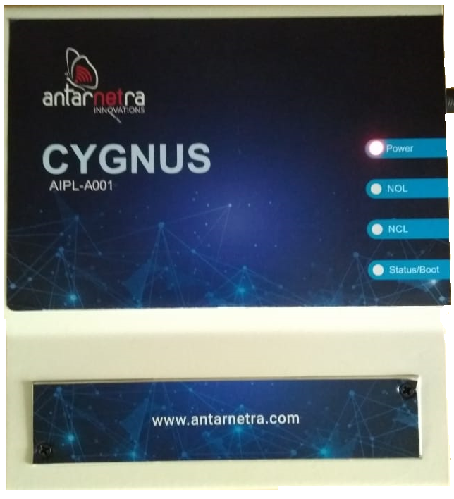
Introduction to CYGNUS
A GSM Based controller to start (switch-on) or stop (switch-off) the connected electrical equipment.
Requires a 2G/3G/4G GSM SIM.
Simple and quick to install
Can be operated from anywhere in the world
Works on SMS and Missed Calls
No smart phone required
User needs to have a basic mobile phone
User-friendly SMS operation codes.
Informs the user about each operation
Also works on user configurable schedules
Detects power-failures and load faults
Can be upgraded to new versions, using ‘Firmware upgrade Over The Air’ - FOTA

Slide 3
Applications of CYGNUS
Water Pump Control
Streetlight Control
Advertizing Display Board Control
ATM booth lights and AC control
Fountain Control
Lawn Sprinkler Control
Other Miscellaneous Usage

Slide 4
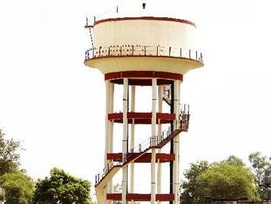
Water Pump Control
Water Pumps used in irrigation
Overhead tanks
Municipal Areas
Railways
Large Townships
CYGNUS Connects to any kind of starter and operates under any load current.
Manual visits to operate the pump becomes a thing of past

Slide 5
Streetlight Control
Streets in Rural/Urban Areas
Highways/Expressways
Streets and parks in Large housing societies
Saves Electricity and requires minimum human intervention.
CYGNUS can switch on/off the lights by an SMS or a Missed Call
CYGNUS can be scheduled to switch on/off the lights at specific times
Schedules can be set or changed using a simple SMS
No need to have bulky mechanical timers or additional electronic timer

Slide 6
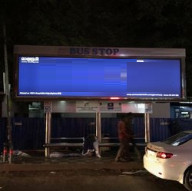
Advertizing Display Board Control
Roadside Billboards
Bus Stops Billboards
CYGNUS helps you save Electricity
It makes you sure that your Electronic Display or Advertisement Display Lights are actually on/off at the pre-defined time

Slide 7
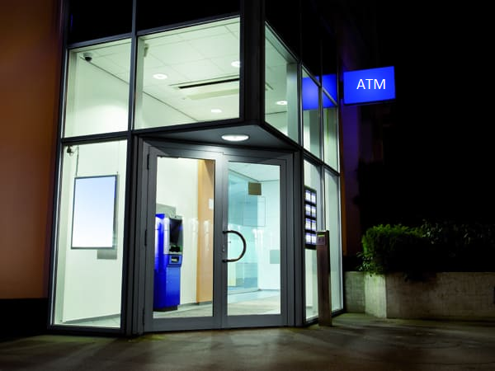
ATM booth lights and AC control
All Bank ATMs
Any other public utility place
CYGNUS lets you save electricity by switching off some lights after a pre-defined time
CYGNUS helps you to save the environment by turning off air conditioners at a given time

Slide 8
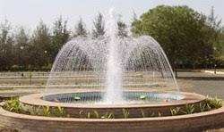
Fountain Control
Roundabouts
Parks
Shopping Malls
CYGNUS can Start or Stop the fountain at your will by an SMS or a Missed Call
CYGNUS can be scheduled to operate the fountains automatically within a certain time-range
Helps you save water and electricity
Requires additional plumbing material, solenoid valves etc that are not manufactured by AIPL.

Slide 9
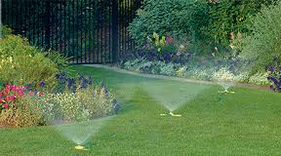
Lawn Sprinkler Control
Parks
Sprawling lawns of Institutions or Individuals
Operate CYGNUS to sprinkle your lawn whenever needed from anywhere in the world.
CYGNUS helps you save both water and electricity and reduces manpower cost.
Requires additional plumbing material, sprinklers, solenoid valves etc that are not manufactured by AIPL.

Slide 10
Other Miscellaneous Usage
Usage of CYGNUS are not limited by the applications listed in this presentation
The mantra of CYGNUS is that it can operate (Switch ON/OFF) Any Electrical Device From Anywhere in the World.
AIPL can customized CYGNUS or offer any other solution based upon your automation needs.

